Slide 1
Unordered_Set in C++

Slide 2
Motivation
1.
Why would we use unordered_set?

Slide 3
We want to store unique elements in a container and we want fast interogation time.

Slide 4
Definition
2.
What is an unordered_set?

Slide 5
Definition
Unordered sets are containers that store unique elements in no particular order, and which allow for fast retrieval of individual elements based on their value:
the value of an element is at the same time its key
the elements in an unordered_set cannot be modified in the container
organized into buckets depending on their hash values to allow for fast access

Slide 6
Properties
3.

Slide 7
Properties
Associative: Elements in associative containers are referenced by their key and not by their absolute position in the container
Unordered: Unordered containers organize their elements using hash tables that allow for fast access to elements by their key.
Set: The value of an element is also the key used to identify it.
Unique keys: No two elements in the container can have equivalent keys.
Allocator-aware: The container uses an allocator object to dynamically handle its storage needs.

Slide 8
Methods
4.
How can we operate upon an unordered set?

Slide 9
Capacity
empty(): test whether container is empty
Complexity: constant
size(): return container size
Complexity: constant
max_size(): this is the maximum potential number of elements the container can hold due to system constraints or limitations on its library implementation
Complexity: constant

Slide 10
Element lookup
find(): get iterator to element
Complexity: constant
count(): count elements with a specific key
Complexity: constant

Slide 11
Modifiers
emplace()
Complexity: amortized constant
emplace_hint()
Complexity: amortized constant
insert()
Complexity: amortized constant
erase()
Complexity: amortized constant
clear()
Complexity: linear
swap()
Complexity: amortized constant

Slide 12
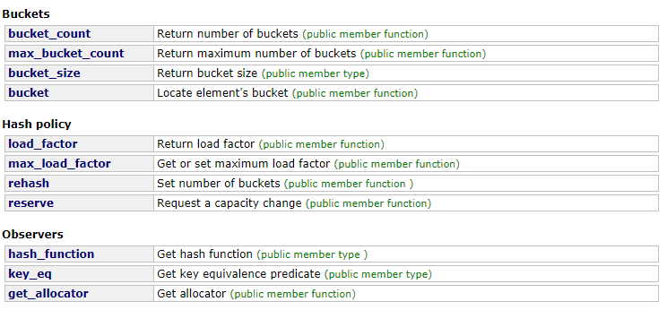
Hash tables
emplace()
Complexity: amortized constant
emplace_hint()
Complexity: amortized constant
insert()
Complexity: amortized constant
erase()
Complexity: amortized constant
clear()
Complexity: linear
swap()
Complexity: amortized constant

Slide 13
Example
5.

Slide 14
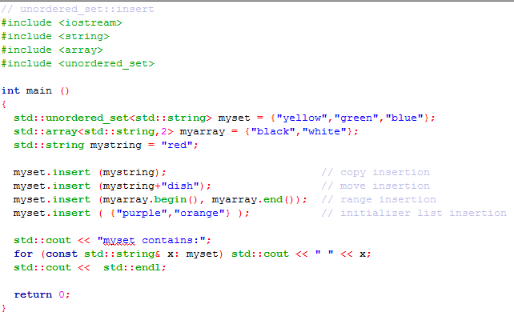
Example

Slide 15
Behind the scene
6.

Slide 16
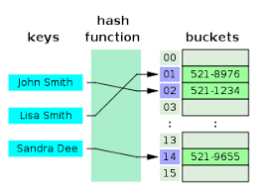
The magic

Slide 17
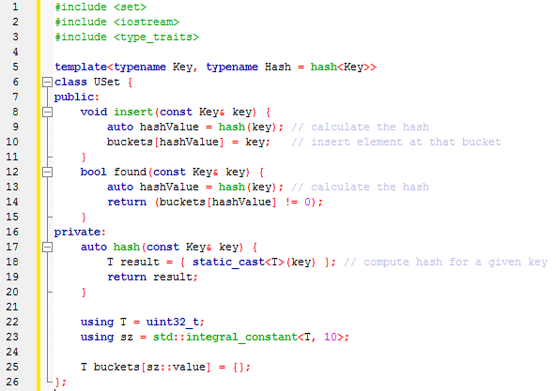
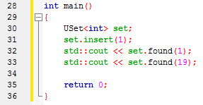
The magic

Slide 18
User defined types in Set
7.

Slide 19
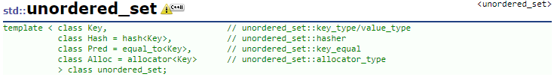
User defined types in Set

Slide 20
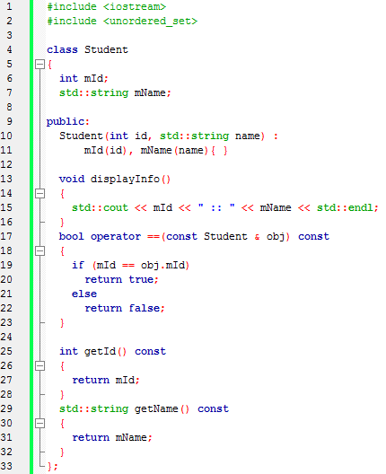
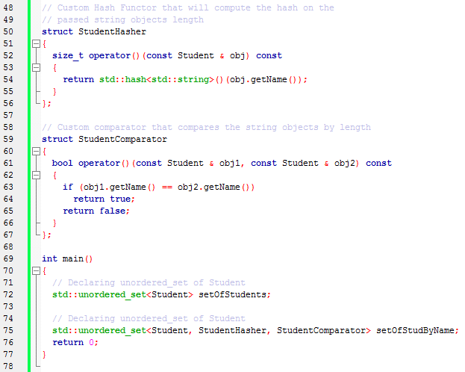
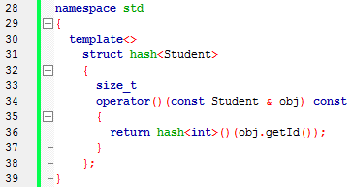
User defined types in Set

Slide 21
Unordered_MultiSet in C++

Slide 22
Motivation
1.
Why would we use unordered_set?

Slide 23
We want to store not just unique elements in a container and we want to maintain fast interogation time.

Slide 24
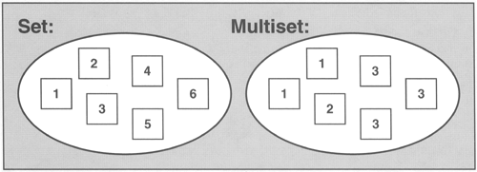
Set vs Multiset

Slide 25
Definition
2.
What is an unordered_set?

Slide 26
Definition
Unordered Multiset is like unordered set:
the value of an element is at the same time its key
the elements in an unordered_set cannot be modified in the container
organized into buckets depending on their hash values to allow for fast access

Slide 27
Examples
3.

Slide 28
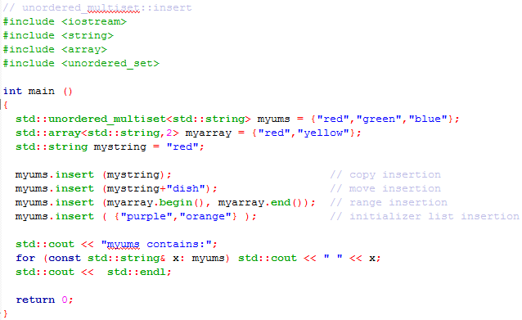
Examples

Slide 29
Unordered_Set vs Unordered_MultiSet

Slide 30
Definition
Unordered Set:
count()
Complexity: constant
Unordered Multiset:
count()
Complexity: amortized linear in the number of elements counted

Slide 31

Q&A
Any questions?

Slide 32

THANKS!

